Slide 2
Hello!
I am Ryan Schmidt
Research Scientist at Autodesk Research
Head of the Design & Fabrication group
I make 3D design tools
Like meshmixer, the software we will be using today

Slide 3
What is a “3D Model”?
Virtual representation of a physical object
Doesn’t necessarily look like the physical object
Representative shape / structure / etc

Slide 4
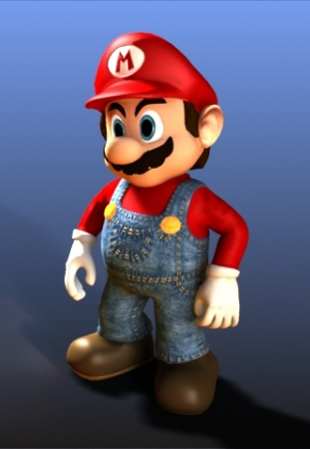
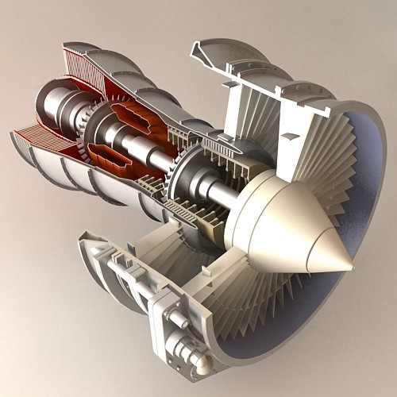
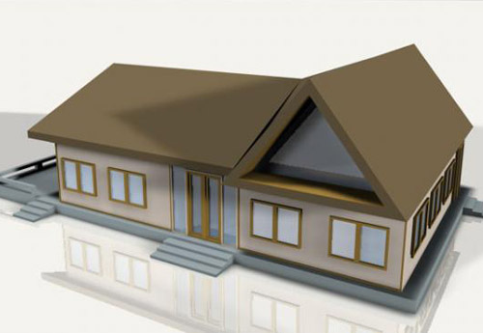
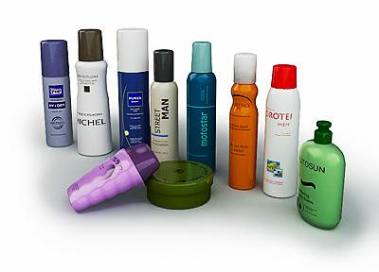
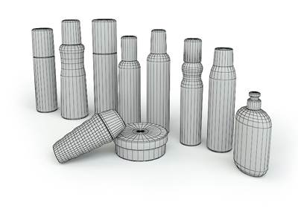
3D Models

Slide 5
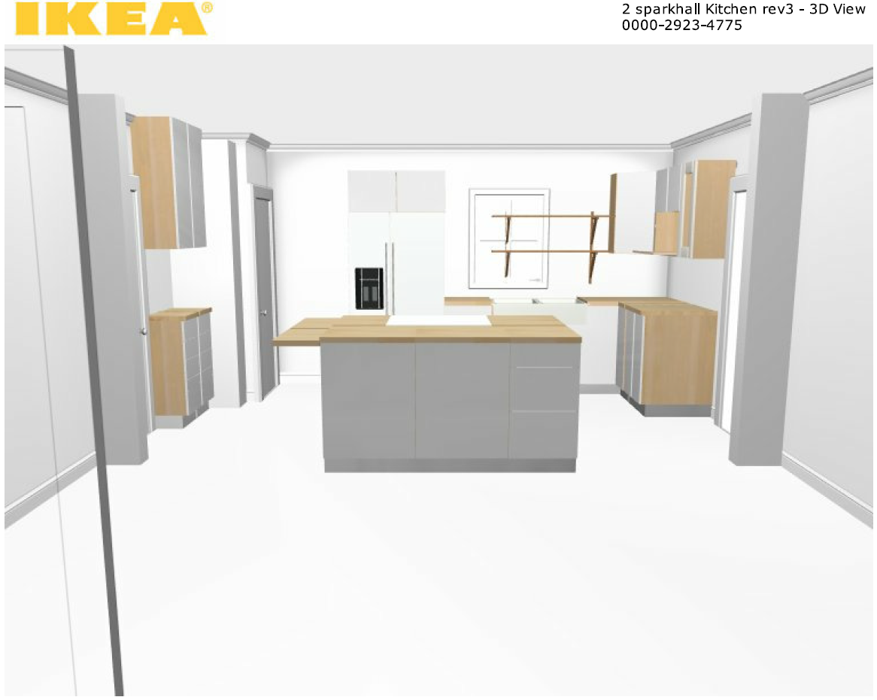
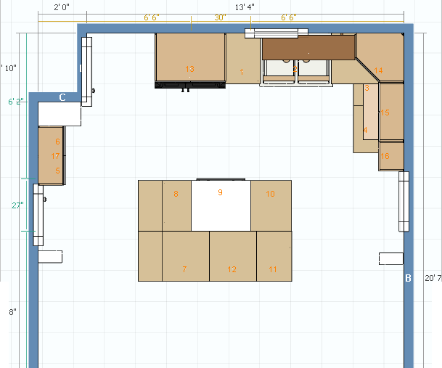

Slide 6
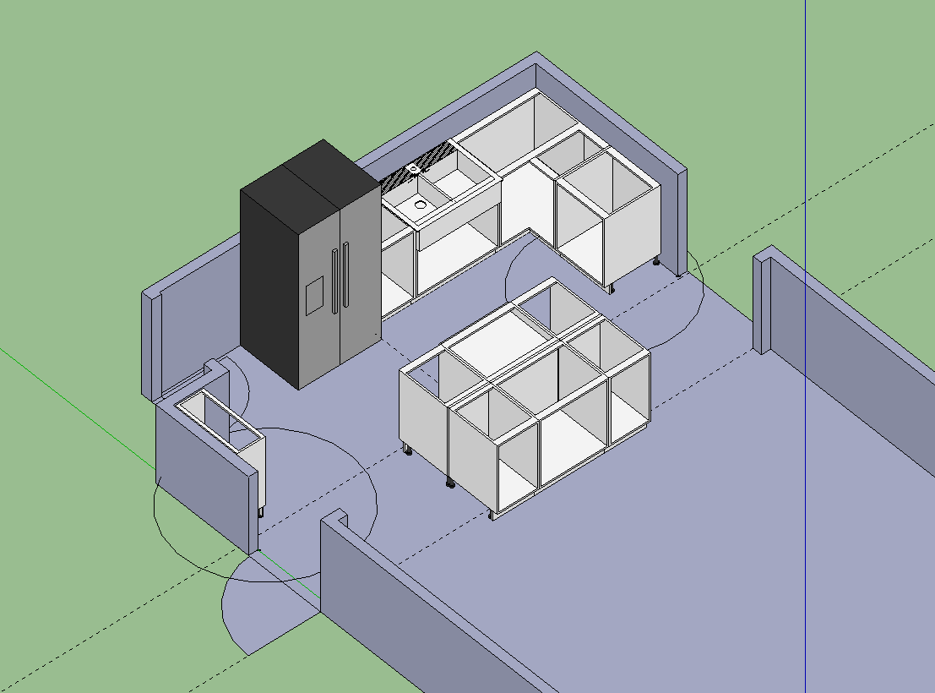

Slide 7
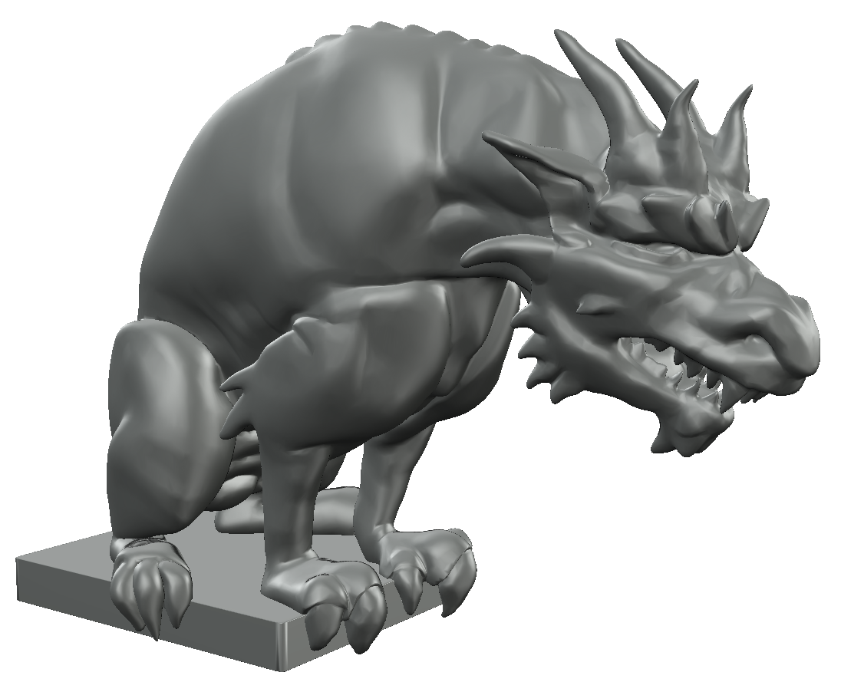
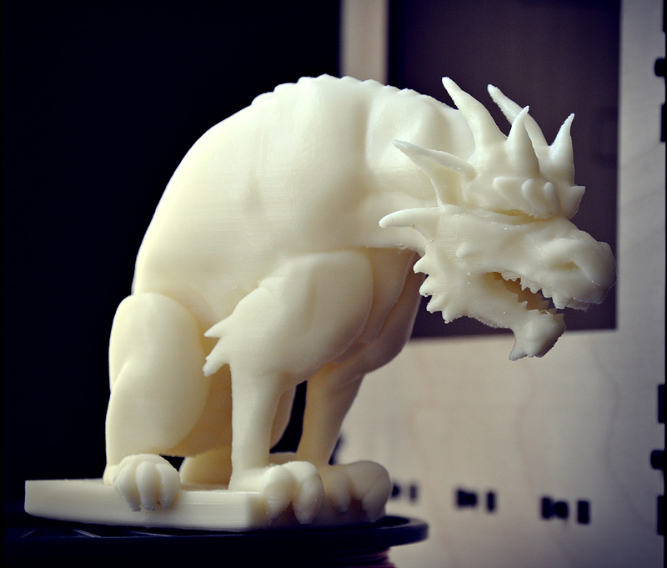
3D Printing
Fizgig’s Gargoyle, created by colinfizgig

Slide 8
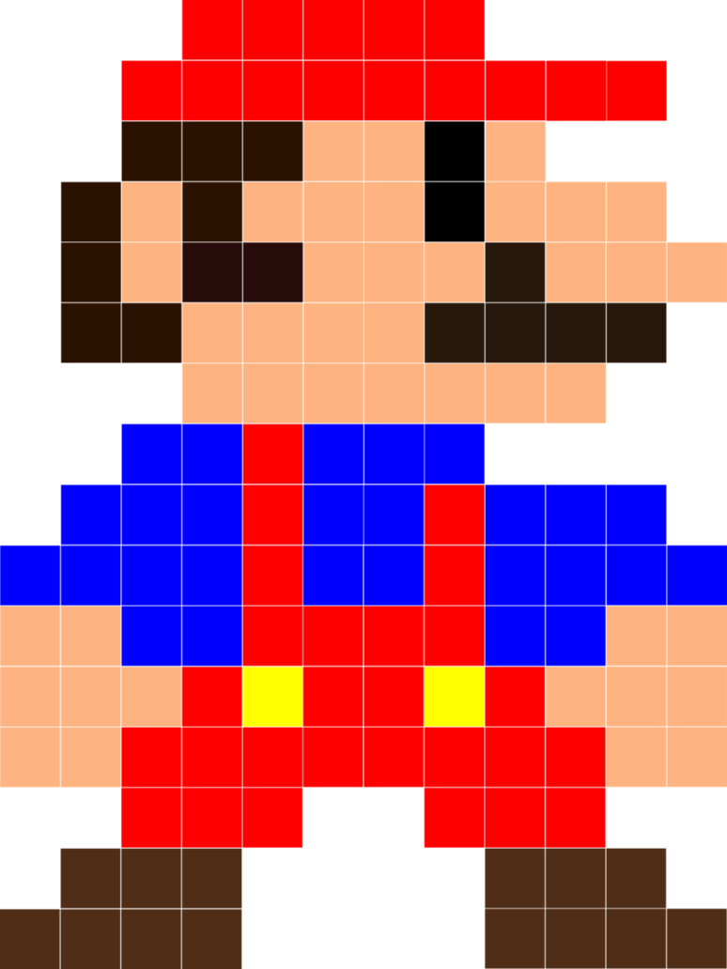
2D Images - Pixels

Slide 9
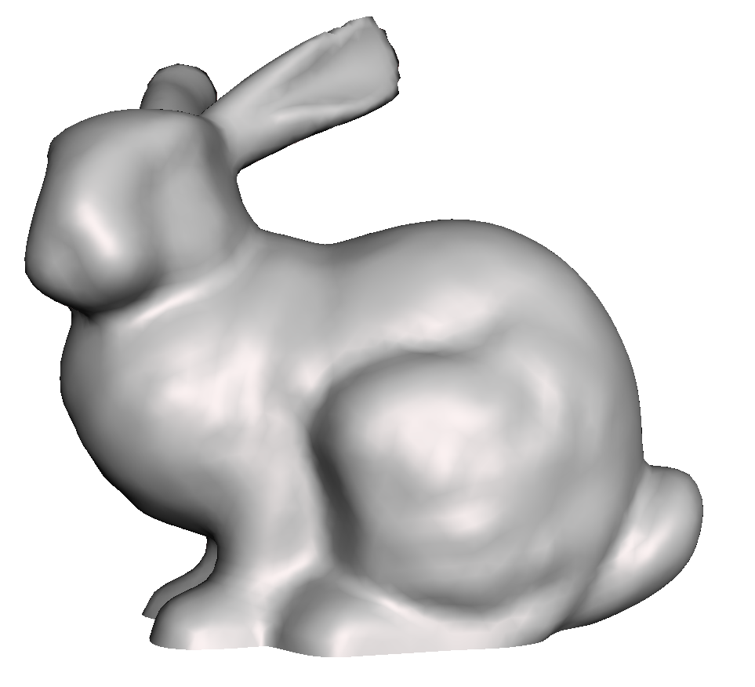
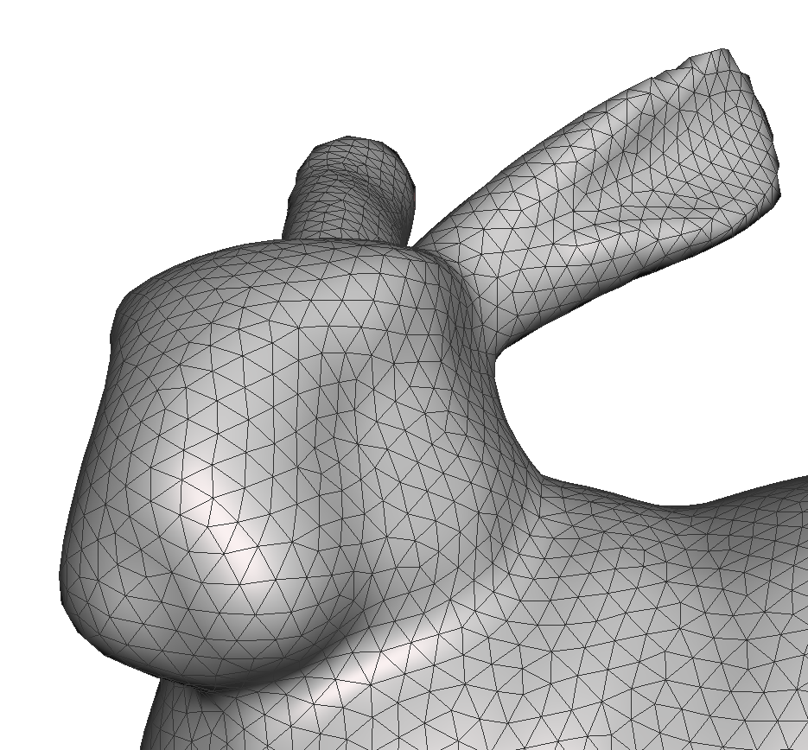
3D Model - Triangles

Slide 10
meshmixer
Made by Autodesk
www.meshmixer.com
Free for Windows and Mac OS X

Slide 11
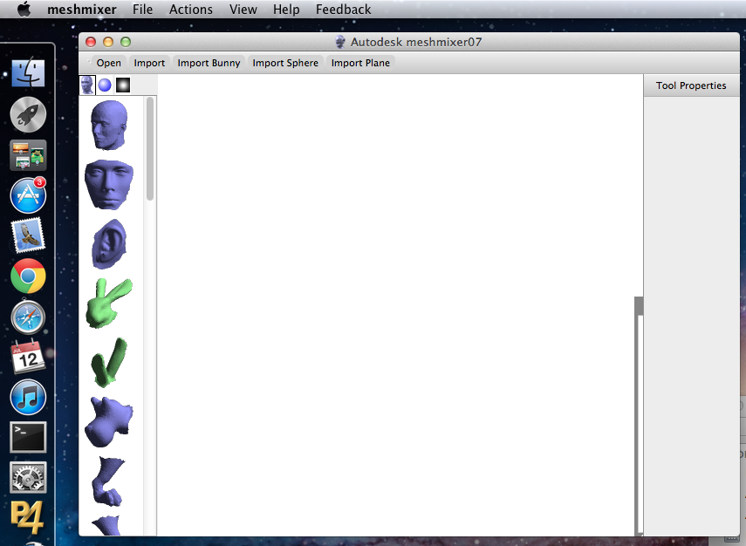
Action Bar
Library Bar
3D Viewport
Properties Bar

Slide 12
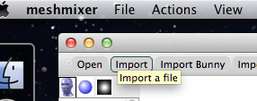
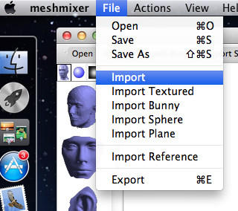
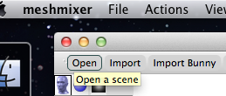
Loading a model in meshmixer
.OBJ, .STL, .PLY, …
.MIX

Slide 13
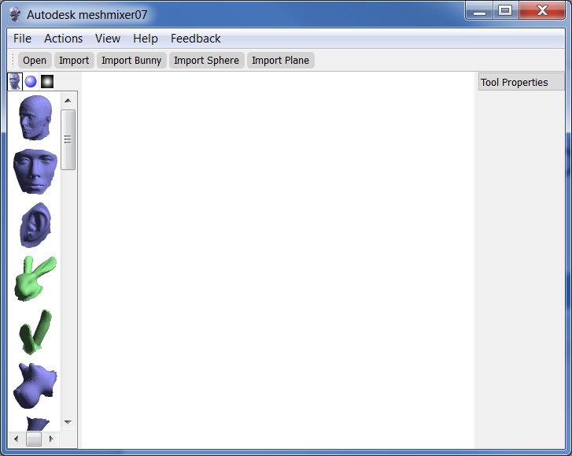
Action Bar
Library Bar
3D Viewport
Properties Bar

Slide 14
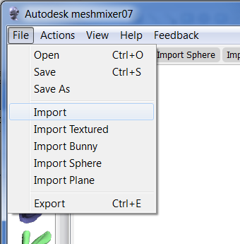
Loading a model in meshmixer
.OBJ, .STL, .PLY, …
.MIX

Slide 15
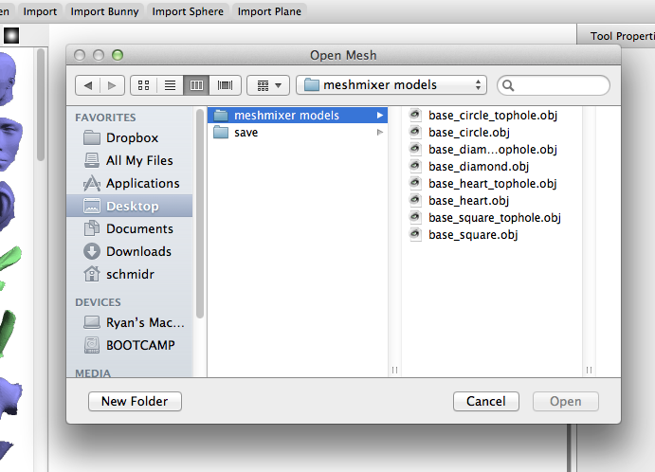

Slide 16
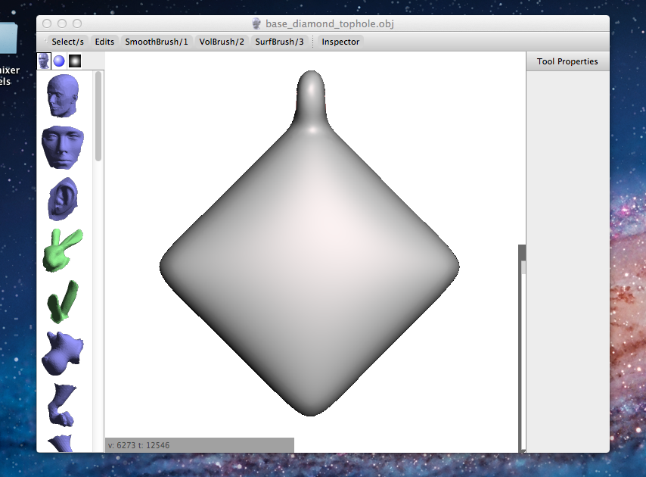

Slide 17
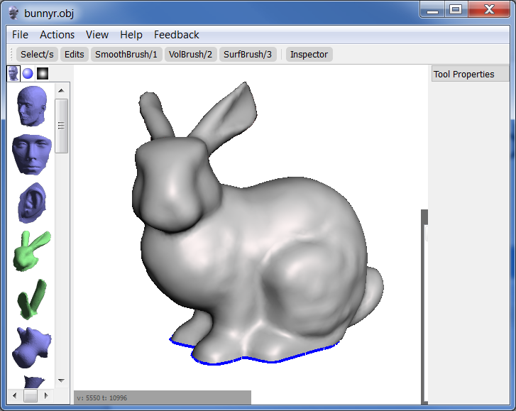

Slide 18
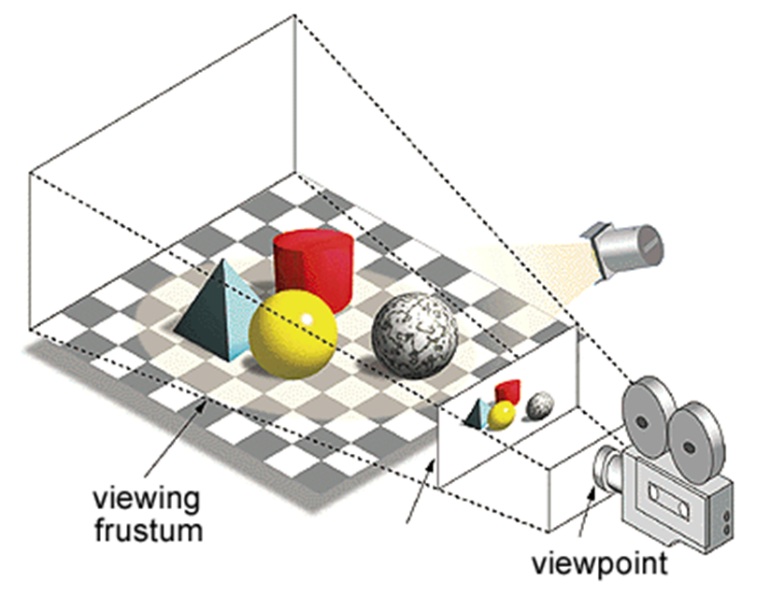
Rendering
Turns 3D things into an image
“Camera into virtual world”

Slide 19
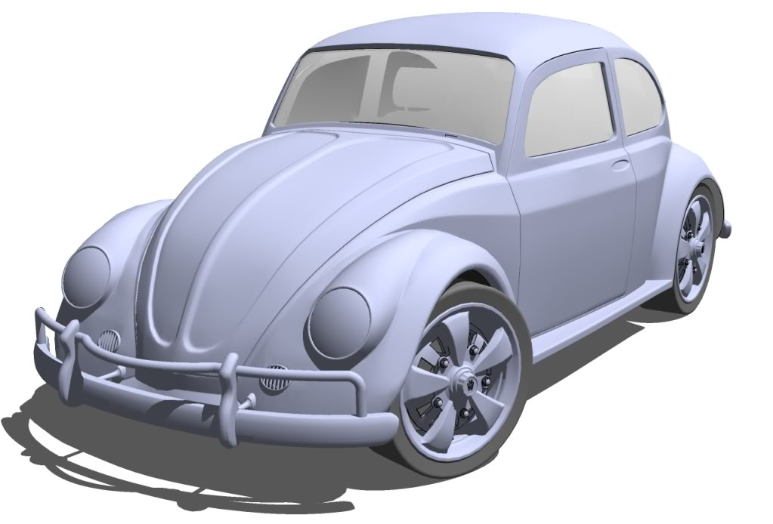
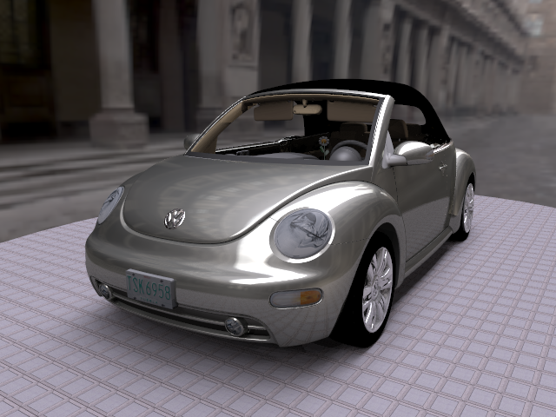

Slide 20
Camera Controls
This is how you move around the virtual world
Analogy to physical camera
Pan
Zoom/Dolly
Tumble/Orbit/Turntable

Slide 21
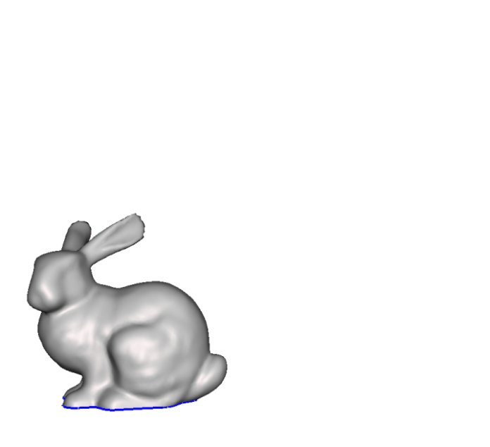
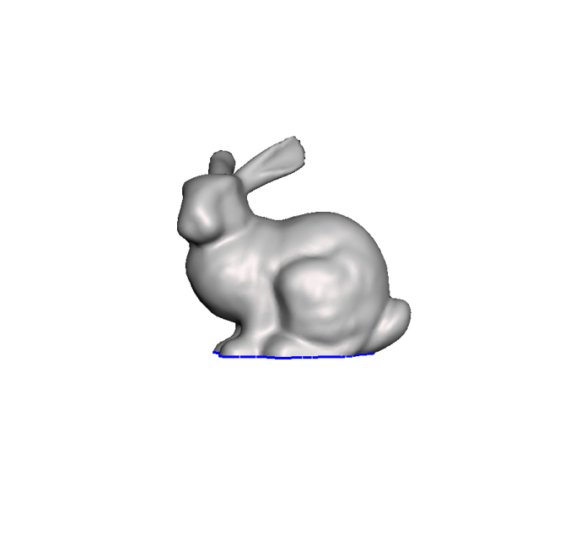
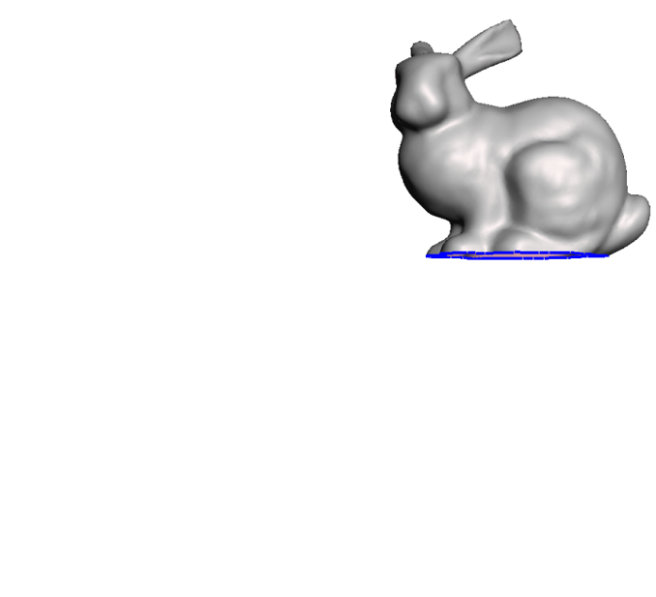
Pan / Translate
“Moving”

Slide 22
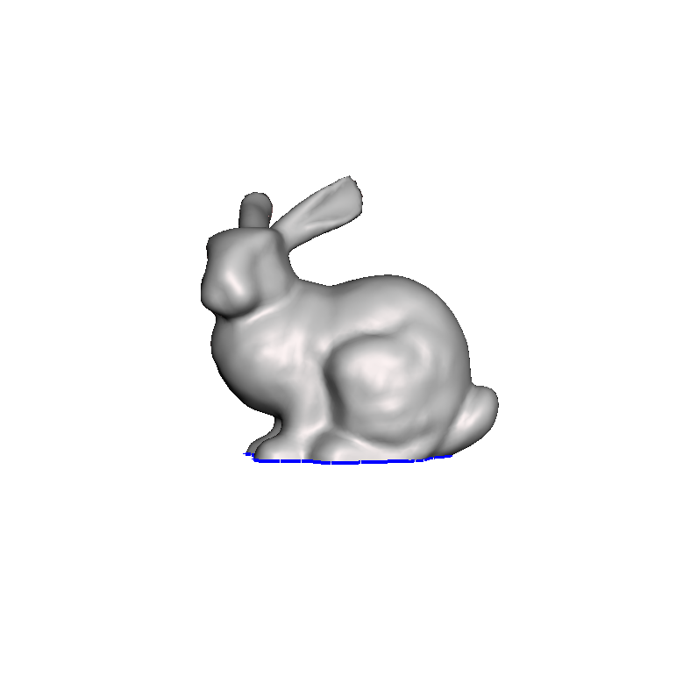
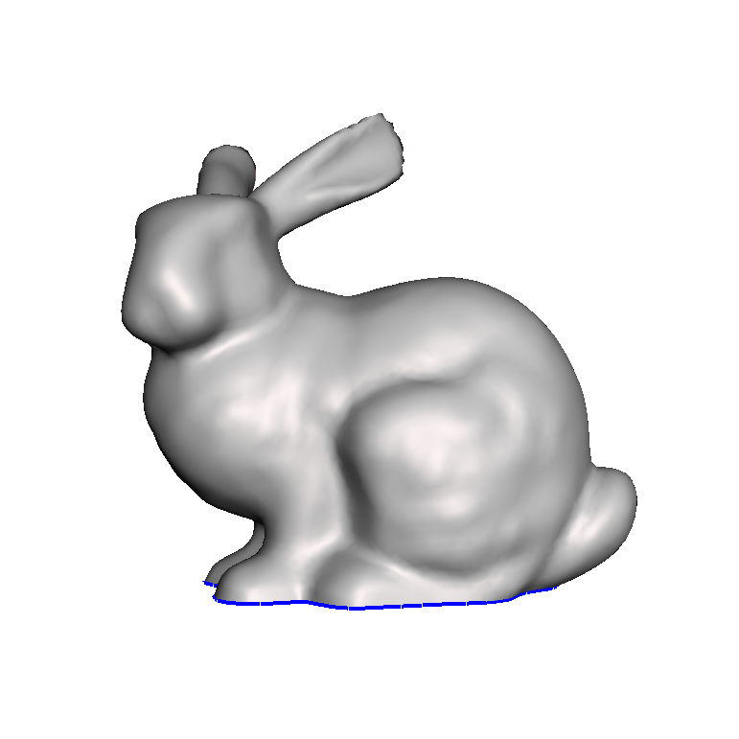
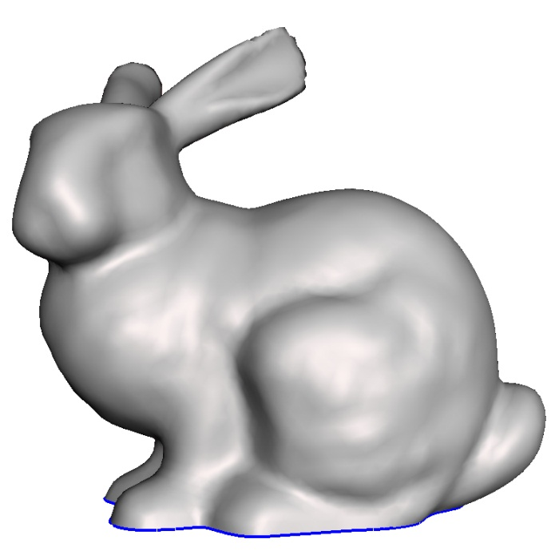
Zoom / Dolly
“Scaling”

Slide 23
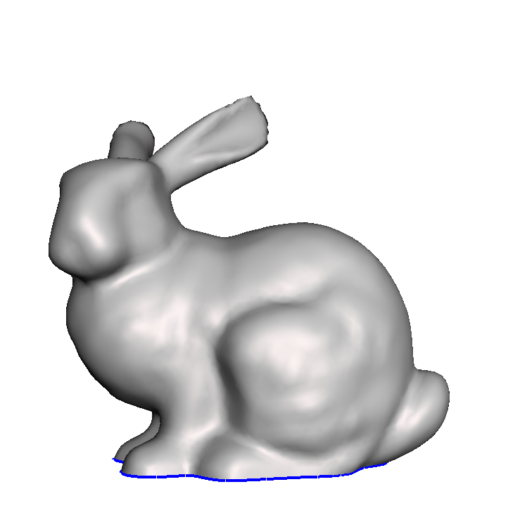
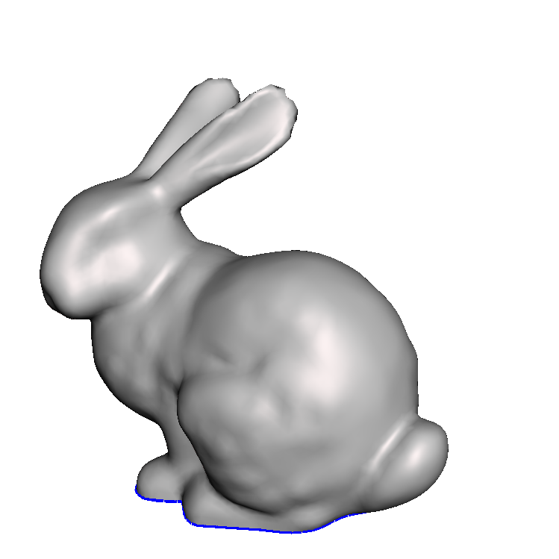
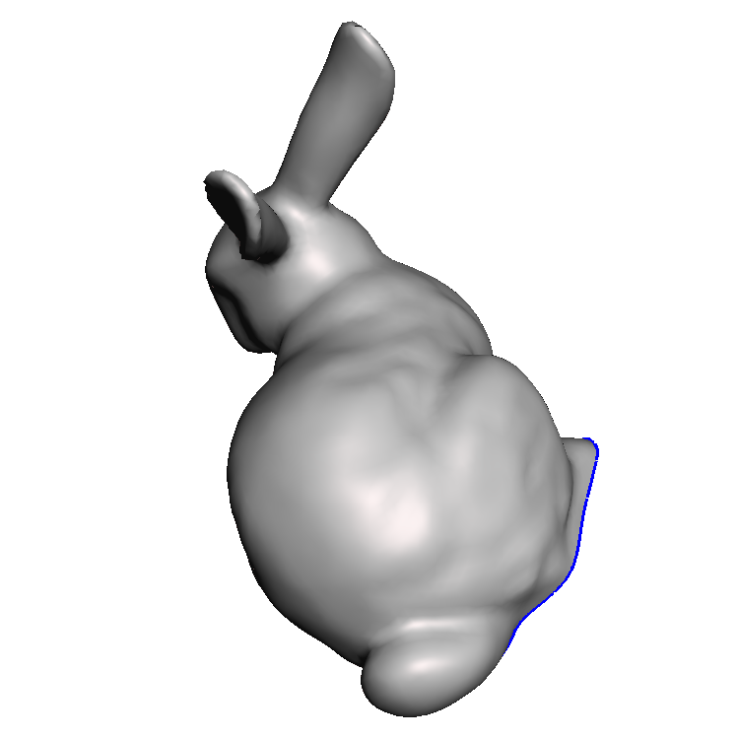
Tumble / Orbit / Turntable
“Rotating”

Slide 24
Camera Controls in meshmixer

Slide 25
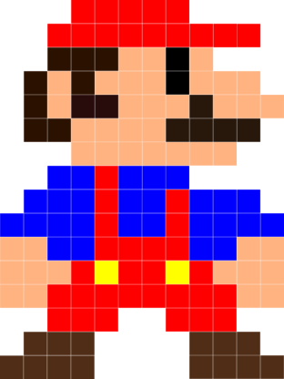
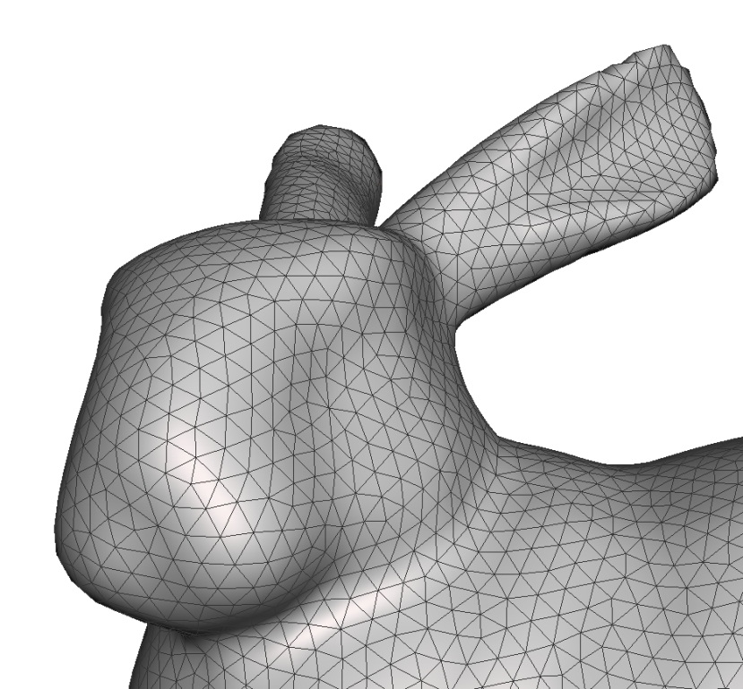
How do we make the triangles??
In 2D Images…
Manipulate individual pixels
Use filters, brushes, etc…
Can place triangles manually (crazy!)
This is how many artists work
Use higher-level tool

Slide 26
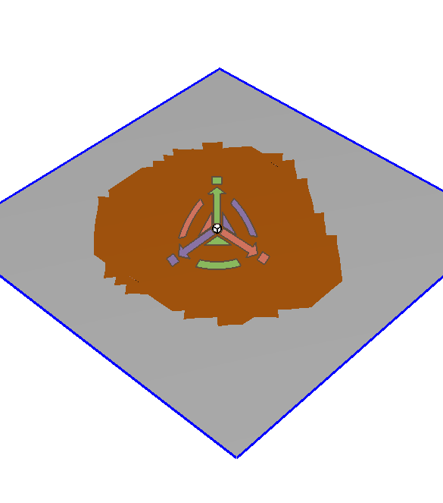
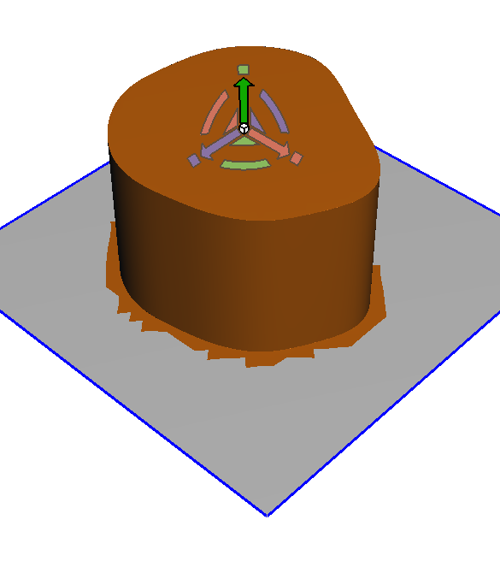
Push-and-pull

Slide 27
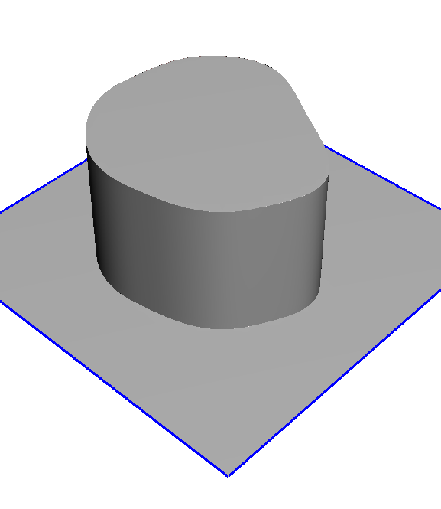
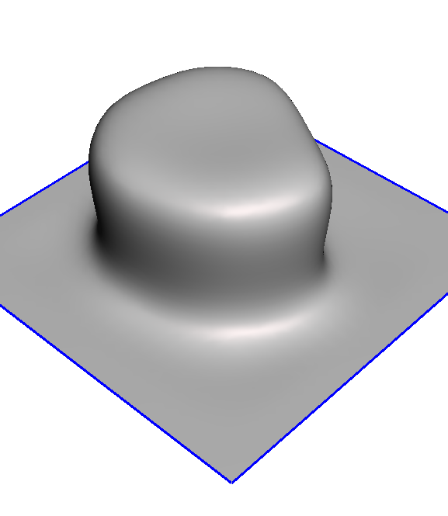
Smoothing / Fairing

Slide 28
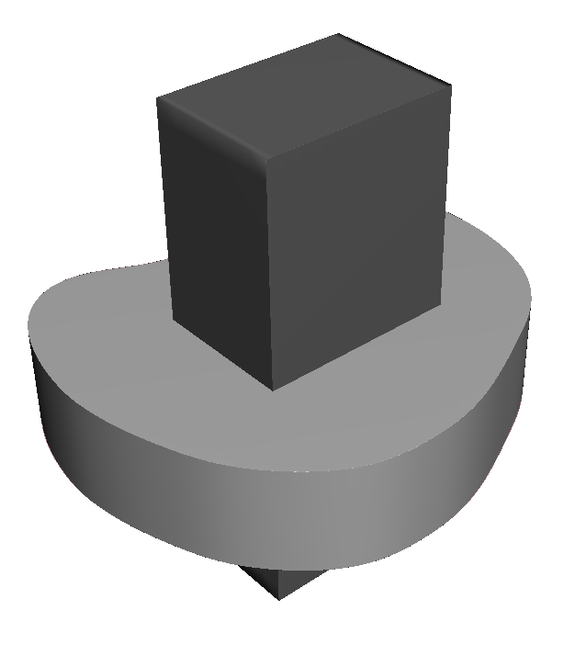
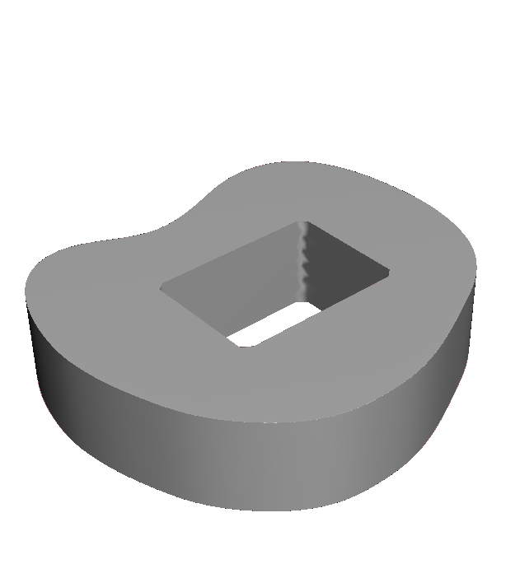
Booleans

Slide 29
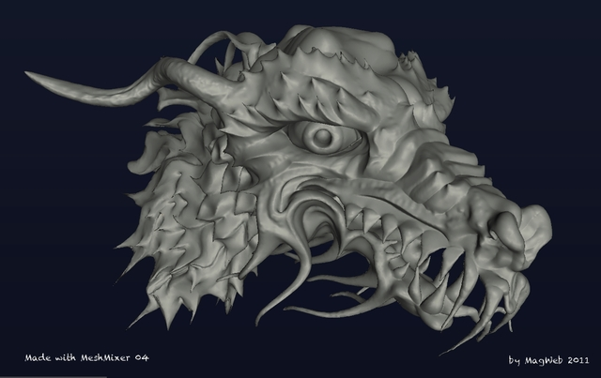
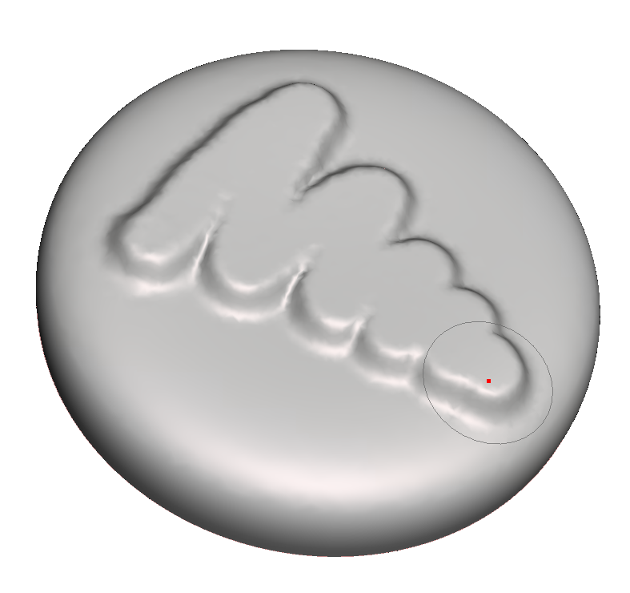
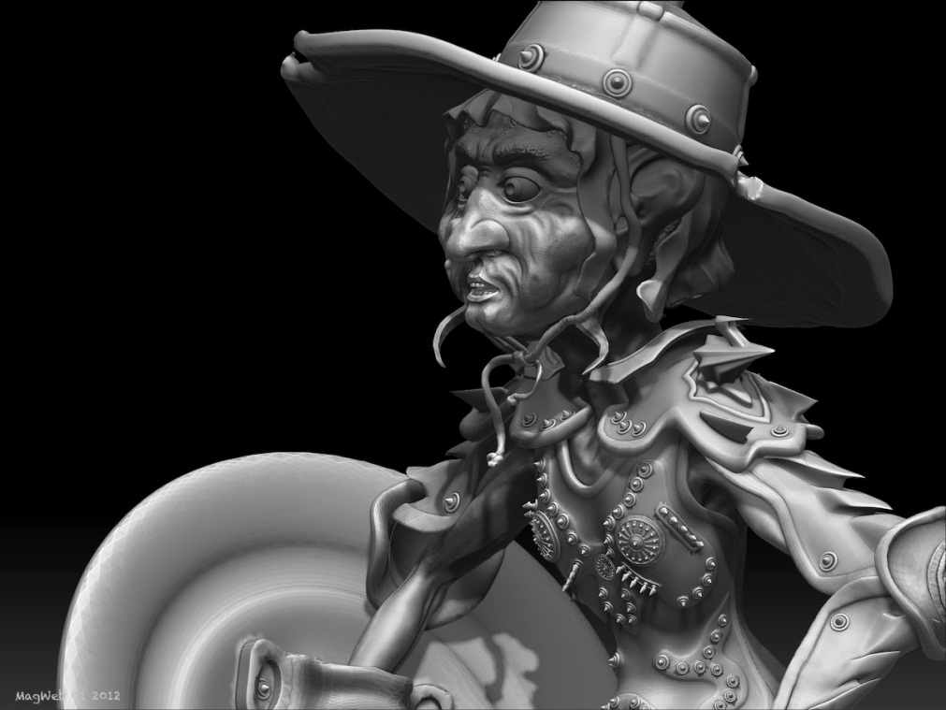
3D Sculpting

Slide 30
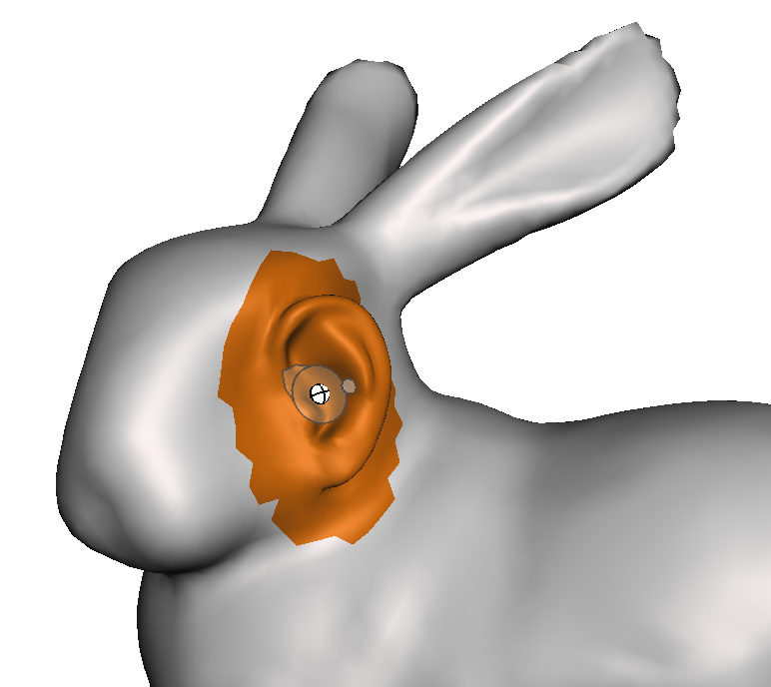
Dropping Parts

Slide 31
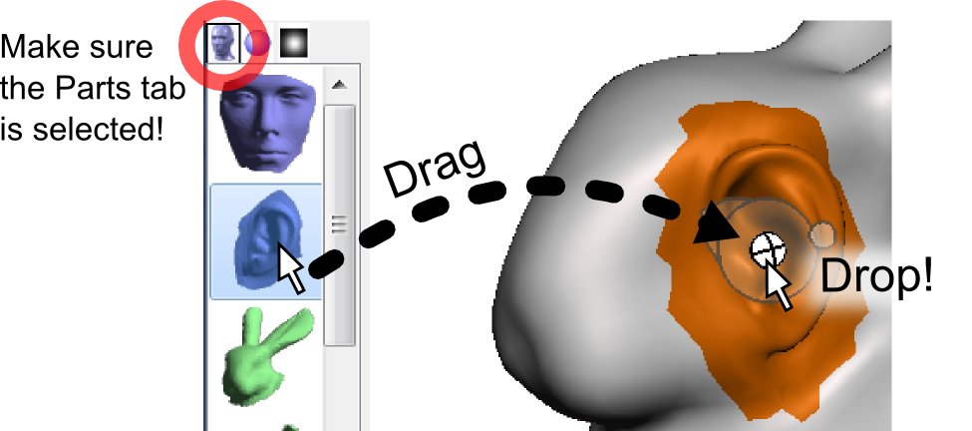
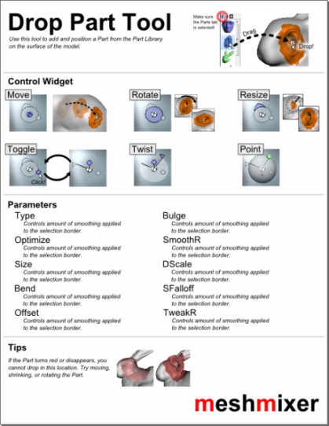
Drop Part Tool

Slide 32
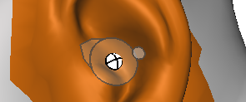
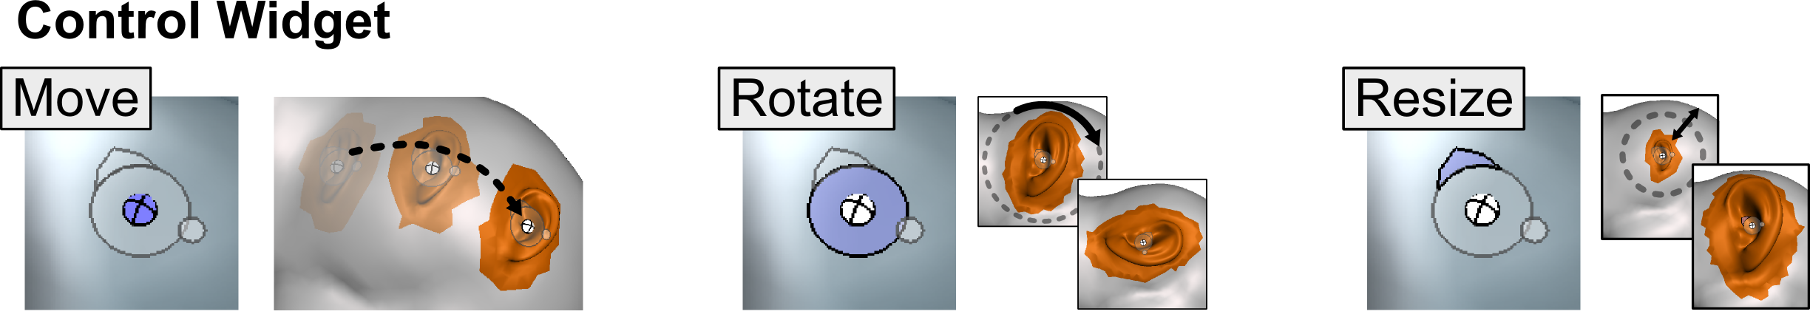
Drop Part Tool

Slide 33
Limitations
If you see this, you can’t drop the Part there…

Slide 34
Smoothing

Slide 35
Smoothing Brush Tool

Slide 36
Selection Tool

Slide 37
Extrusions

Slide 38
1
2
1
2

Slide 39
Smoothing
1
2
Notes:
How to show changing smoothness??

Slide 40
Creating a Collar

Slide 41
Select
Smooth Boundary
Extrude
Set Direction to Normal
Remesh
Smooth
Maximum smoothness

Slide 42
Sculpting Brushes

Slide 44
Exporting Models
Two formats
OBJ
Format for saving your model
STL
Format for sending to printer

Slide 48
3D Printing

Slide 49
https://www.youtube.com/watch?v=8_vloWVgf0o

Slide 52
Limits of 3D Printing
Print volume
Overhangs
Thickness

Slide 53
Print Volume
Print Time is proportional to 3D Volume and Surface Complexity
To print in 30 minutes, your objects will have to be SMALL and FLAT

Slide 54
Overhangs
Print is from Bottom To Top
“Overhangs” need to be supported

Slide 55
Size / Thickness
3D printers have limited RESOLUTION

Slide 56
Ready, Set, MAKE!

Slide 59
Other Free Tools
123D Sculpt on iPad
123D Catch
123D Make
SketchUp
Sculptris
NetFabb
MeshLab

Slide 60
Mesh File Formats
OBJ
STL
DAE/Collada
PLY,3DS,FBX,…

Slide 61
Colors
Materials/Texture
UV Maps

Slide 63
Creating a Collar
Select
Smooth Boundary
Extrude
Direction: Normal
Remesh, Smooth

